Slide 1

Windows Hello for Business
Charity Shelbourne
Principal Product Manager
Identity Engineering
JJ Streicher-Bremer
Senior Identity ACE Engineer
Identity Engineering

Slide 2





Authentication methods
aka.ms/gopasswordless
Best: Passwordless
Bad: Password
Better: Password and…
123456
qwerty
password
DadstheBest
TestPassword123
Push
Notification
Windows Hello
for Business
Soft
Tokens OTP
Microsoft
Authenticator
Hard
Tokens OTP
FIDO2
Security key
SMS, Voice
Certificate-based authentication (PIV/CAC)
Notes:
Key Point : Not all Authentication Methods are equal
Good - Telecom based methods like SMS and voice can provide an additional layer of verification but they’ve a dependency on telecom providers, end users need connectivity and it may cost the end user. We seen during COVID-19- telecom providers having outgas resulting in users who are unable to complete their MFA prompts. Advance attacks, not helping with reducing prompts.
Better - Microsoft authenticator app provides a better experience where the user can either approve a notification or enter a one-time passcode to verify their identity.
Software OTP can be achieved with the Auth app but also with any 3rd party Authenticator app and finally Hardware tokens that provide time based OTP. The benefit of all of these methods is that they don’t relay on cellular connectivity. Push notification can be used over wireless network and software and hardware don’t need any connectivity.
Best – our premier experience
WH4B – best for reducing prompts
FIDO2 – these provider quick and easy passwordless experience for users by touching a key during the sign-in.
We offers multiple solutions for passwordless authentication and you learn more about it here in this aka.ms link

Slide 3
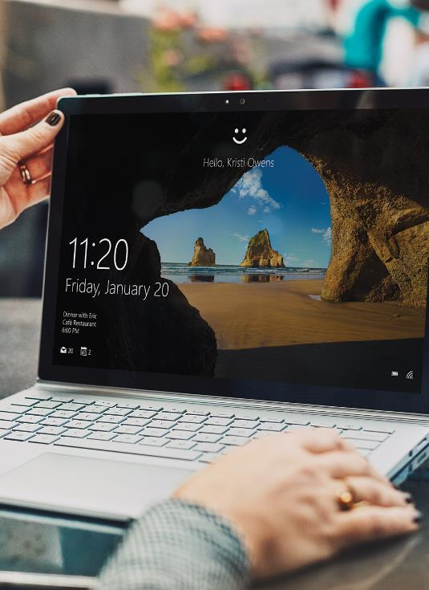
Windows Hello for Business
User friendly
Password-less: Biometrics or PIN
SSO for both native and web apps on Windows
Enterprise-grade
Strong two-factor authentication
Asymmetric key pair auth model
Can be deployed in cloud, hybrid, or on-prem environments
Private key is never shared
Keys are generated in hardware (TPM) when available
User’s biometrics are not stored in the cloud
aka.ms/WHfB
Notes:
Speaker notes :
Replace passwords with a private key - an asymmetric key pair or a certificate
Private key is never shared- never leaves the device.
Keys are ideally generated in hardware (TPM)
User Identities can have multiple devices with multiple different key pairs.

Slide 4
Where do I start?
Start by determining trust type
Determines how clients authenticate to on-premises Active Directory
Based on a certificate or an asymmetrical key pair
Key or cert is tied to device and PIN and/or biometric

Slide 5
Windows Hello for Business Trust Types
Trust type: Determines how WHFB clients authenticate to on-prem Active Directory.
Authentication to Azure AD is always via Asymmetric keys
 | Deployment Trust Type | Deployment Trust Type
 | Cloud Kerberos Trust | Key Trust | Certificate Trust
Environment/ Device Join type
Cloud Only ( Azure AD Joined) |  | 
Hybrid ( Hybrid Azure AD Joined) |  |  | 
On-Premises Only ( Domain Joined) |  |  | 

Slide 6
Deployment models
 | Trust Types
 | Cloud Kerberos Trust | Key Trust | Cert Trust
Architecture | Uses architecture designed for FIDO2 security keys to enable hybrid authentication scenarios | User provisions RSA key pair on device. Public key is registered with Azure AD and is synced back to AD | A certificate is enrolled for the end user for their RSA key pair.
Authentication | Simplified the deployment experience for Windows Hello for Business | Key based authentication is used by the client when trying to access AD or AAD resources | Key based authentication when trying to access AAD Certificate based authentication when trying to access AD
Public Key Infrastructure (PKI) | No PKI required | Enterprises want to reduce PKI management | For orgs that have PKI for issuing and managing certificate
Domain Controller | No Domain Controller certificate required | Requires Domain Controller and a DC certificate | Requires Domain Controller and a DC certificate
Key writeback/sync | No key sync required. Instant logon access for on-premises SSO. | The public key is written to Azure AD and synced to AD. Expect Key sync delay for on-prem SSO. | In hybrid environment with Cert Trust – Cert enrollment happens at provisioning time and available immediately

Slide 7
Still trying to decide?
If you have a Certificate Authority and smart card infrastructure, you might find transitioning from physical smart cards to WH4B with Cert Trust easier to adopt
If you are primarily on-premises, they may benefit from Key Trust type or both Key Trust and Cloud Kerberos Trust type.
If you are looking to move primarily to the cloud, Cloud Kerberos Trust type would be a better match
Bottom line:
Use Cloud Kerberos Trust unless you have a compelling reason to use a different deployment model

Slide 8


Why Cloud Kerberos Trust?
Sync Delay
FIDO Unlock
Cert requirements
Bottom line:
Use Cloud Kerberos Trust unless you have a compelling reason to use a different deployment model

Slide 9



Cloud Trust Deployment Prerequisites
1
Windows Client Version
Windows 10, Version 21H2 (OS build 19044) with KB5010415
Windows 11, Version 21H2 (OS build 22000) with KB5010414
Azure AD Connect
Users and devices synced
Domain Controller :
Windows Server 2016 or later Domain Controllers
Server 2016 with KB4534307 (2020-01 CU)
Server 2019 with KB4534321 (2020-01 CU)
Azure AD Kerberos Configured
Device Management
Devices hybrid or Azure AD domain joined
MFA
4
Domain | Key
Contoso | 394hwp…
Redmond | Dreo322…
2
Azure AD
Azure AD Kerberos Service
3
2
Azure AD Connect
4
1
3
5
Domain | Key
Contoso | 394hwp…
Redmond | Dreo322…
Windows Client
Active Directory
6
5
6

Slide 10
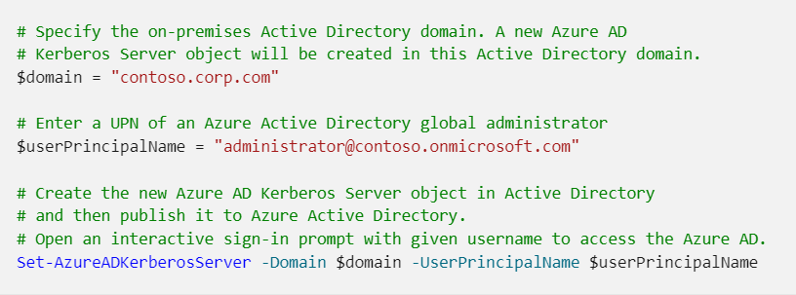
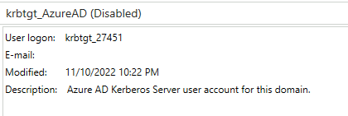
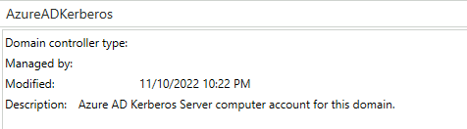
Step 1: Ensure Prereqs are Done
Devices must be hybrid or Azure AD domain joined
Azure AD Kerberos must be enabled
aka.ms/AzureADKerberos

Slide 11
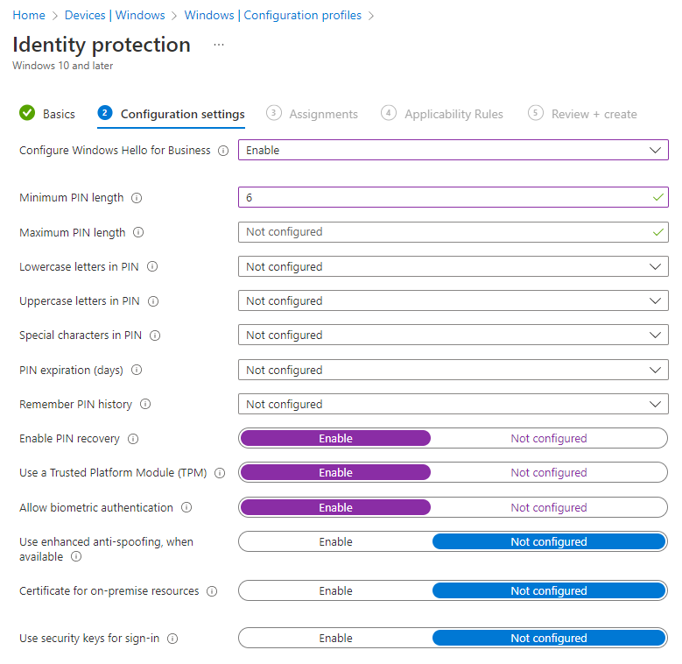
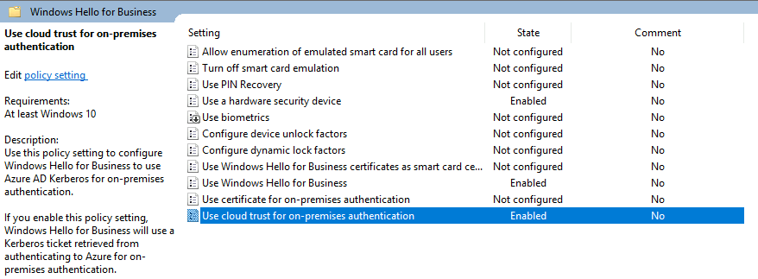
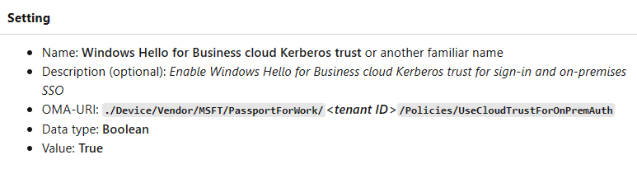
Step 2: Deploy policies
Enable Windows Hello for Business
Enable cloud Kerberos trust
Use biometrics (optional)

Slide 12
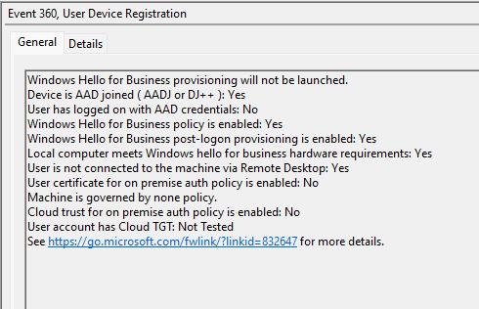
Windows Event Log/User Device Registration Pre-Req Checks
What we check
What we don’t check
Device join
PRT
Policy enabled
Post-logon provisioning enabled (optional)
Hardware requirement check (tpm)
User is not remote
Cert trust or not
Cloud trust enabled
Cloud TGT (on-prem TGT, not cloud TGT)
Internet connectivity (required)
Line of sight to a DC for 1st logon (required HAADJ only)
PRT is healthy and current (required)

Slide 13
Importance of End User Communication
End user communication templates (aka.ms/adminmails )
Focus on end user benefits
Monitor using Authentication methods Activity report
Can’t enforce registration to be complete (user can fail MFA and bypass registration)
Monitor registration using Authentication methods Activity report
Target messages to non-compliant users
User may choose not to use WHfB
Policy: Interactive logon: Require Windows Hello for Business or smart card
Can be problematic and not recommended right now
Use password randomizing or scrambling for now
Notes:
Interactive logon: Require Windows Hello for Business or smart card | Microsoft Learn

Slide 14
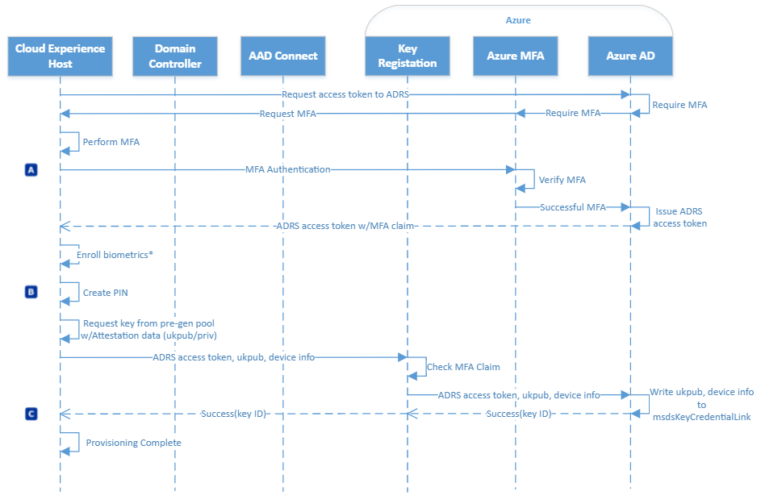
How Cloud Kerberos Trust Provisioning Works
User enters credentials (A)
Provisioning kicks off with request to Azure Device Registration Service (ADRS) for access token
User performs MFA
ADRS access token returned
User enrolls in biometrics (B)
User creates pin (mandatory)
Key pair requested
User key registration occurs
Public key with device ref written to user
Key ID returned to client (C)
aka.ms/WHfB/provisioning

Slide 15
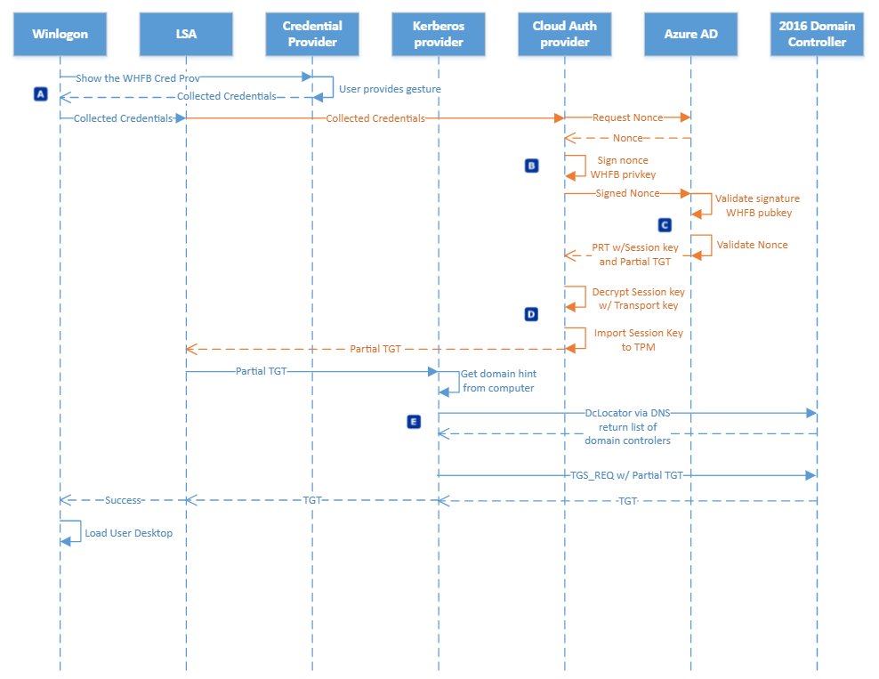
How Cloud Kerberos Trust authentication works
User logs in with WHfB credentials (A)
Nonce signed with WHfB private key and returned to Azure AD (B)
Azure AD validates & returns PRT with encrypted session key + partial TGT to client (C)
Session key is decrypted & protected in TPM and PRT + partial TGT are cached (D)
Dclocator locates DC & exchanges partial TGT for full TGT, caches, & user desktop is loaded (E)
aka.ms/WHfB/auth

Slide 16

How Cloud Kerberos Trust authentication works
Sign-in to Windows with WHFB by authenticating to Azure AD.
2
1
Domain | Key
Contoso | 394hwp…
Redmond | Dreo322…
Azure AD Kerberos Service
Azure AD checks for a Kerberos server key matching user’s on-prem AD Domain and generates a partial Kerberos TGT for on-prem domain. Partial TGT contains user SID only and no authorization data such as groups.
Azure AD
2
1
3
The partial TGT is returned to the client along with Azure AD Primary Refresh Token (PRT).
Azure AD Connect
3
4
Client contacts on-premises AD Domain Controller and exchanges the partial TGT for a full TGT. This is the same protocol flow used today for Read Only Domain Controller scenarios.
4
Domain | Key
Contoso | 394hwp…
Redmond | Dreo322…
Windows Client
5
Active Directory
5
Client has Azure AD PRT and a full Active Directory TGT.

Slide 17
DEMO
Notes:
So that brings us to our demos. JJ, did you want to take it away?

Slide 18
Windows Hello for Business Deployment Plan
1
2
3
4
Determine Trust Type
Ensure prereqs are in place
Deploy policies
Encourage end users
aka.ms/WHfB/DeployCloudTrust

Slide 19
Windows Hello for Business Documentation
aka.ms/WHfB
aka.ms/AzureADKerberos
aka.ms/WHfB/provisioning
aka.ms/WHfB/auth
aka.ms/hellofaq
aka.ms/adminmails
aka.ms/gopasswordless

Slide 20

Thank you

